Slide 1
Chapter 6
Cellular Respiration: Obtaining Energy from Food

Slide 2
Energy Flow and Chemical Cycling in the Biosphere
All life requires energy. In almost all ecosystems on Earth, this energy originates with the sun.
During photosynthesis, plants and other autotrophs (“self-feeders” 독립영양체) convert the energy of sunlight to their own organic matter, including carbohydrates, lipids, proteins, and nucleic acids, from nutrients that are entirely inorganic: carbon dioxide from the air and water and minerals from the soil.
Humans and other animals, heterotrophs (other-feeders 종속영양체) depend on this conversion for food and more.
Notes:
2
Student Misconceptions and Concerns
1. Students should be cautioned against making statements that “energy is created” when it is converted from one form to another. This might be a good time to review the principle of conservation of energy (the first law of thermodynamics).
2. Students frequently think that plants have chloroplasts instead of mitochondria. Care should be taken to point out the need for mitochondria in plants when photosynthesis is not efficient or possible (such as during the night).
Teaching Tips
1. You might wish to elaborate on the amount of solar energy striking Earth. Every day Earth is bombarded with solar radiation equal to the energy of 100 million atomic bombs. Of the tiny fraction of light that reaches photosynthetic organisms, only about 1% is converted to chemical energy by photosynthesis.
2. You might share with your students that it takes about 10 million ATP molecules per second to power one active muscle cell.
3. Energy coupling at the cellular level may be new to many students, but it is a familiar concept when related to the use of money in our society. Students might be discouraged if the only benefit of work was the ability to make purchases from the employer. (We all might soon tire of a fast-food job that pays its employees only in food!) Money permits the coupling of the generation of value (a paycheck, analogous to an energy-releasing reaction) to an energy-consuming reaction (money, which enables us to make purchases in distant locations). This idea of “earn and spend” is a common concept we all know well.
Active Lecture Tips
1. See the activity Photosynthesis and Respiration: Are They Similar? on the Instructor Exchange. Visit the Instructor Exchange in the MasteringBiology instructor resource area for a description of this activity.

Slide 3
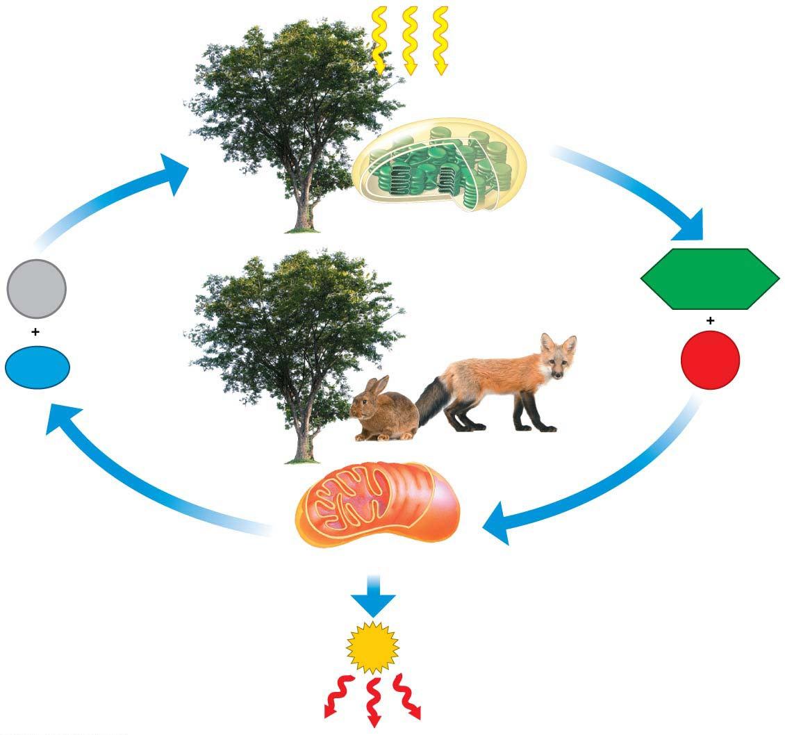
Figure 6.2
Sunlight energy
enters ecosystem
producers
Photosynthesis
CO₂
C₆H₁₂O₆
H₂O
O₂
Cellular respiration
consumers
ATP
drives cellular work
Heat energy exits ecosystem
Notes:
Figure 6.2 Energy flow and chemical cycling in ecosystems

Slide 4
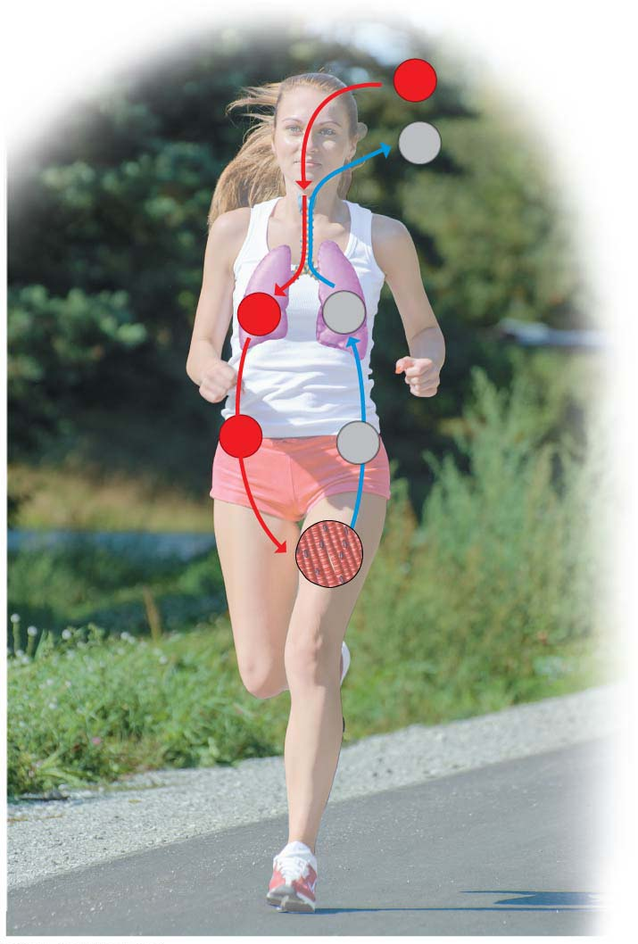
Figure 6.3
O₂
CO₂
Lungs
O₂
CO₂
O₂
CO₂
Muscle cells
Cellular
respiration
Notes:
Figure 6.3 How breathing is related to cellular respiration

Slide 5
Energy Transformations: An Overview of Cellular Respiration세포호흡
The many chemical reactions that make up cellular respiration can be grouped into three main stages:
glycolysis해당과정,
the citric acid cycle, and
electron transport전자전달.
Notes:
5
Student Misconceptions and Concerns
1. Perhaps more than anywhere else in general biology, students studying aerobic metabolism fail to see “the forest for the trees.” Students often focus on the details of each stage of aerobic metabolism and devote little attention to the overall process and products. Consider emphasizing the products, locations, and energy yields associated with glycolysis, the citric acid cycle, and electron transport before detailing the specifics of each reaction. Figure 6.4 can be especially helpful in providing physical orientation to these cellular processes.
2. Students often fail to realize that aerobic metabolism is a process generally similar to the burning of wood in a fireplace or campfire. Pointing out the general similarities can help students comprehend the overall reaction and heat generation associated with both processes.
3. The advantage of the gradual degradation of glucose may not be obvious to some students. Many analogies exist that reveal the advantages of short and steady steps. Fuel in an automobile is burned slowly to best utilize the energy released from the fuel. A few fireplace logs release gradual heat to keep a room temperature steady. In both situations, excessive use of fuel can be wasteful, reducing the efficiencies of the systems.
Teaching Tips
1. During cellular respiration, our cells convert about 40% of our food energy to useful work. The other 60% of the energy is released as heat. We use this heat to maintain a relatively steady body temperature near 37°C (98–99°F). This is about the same amount of heat generated by a 75-watt incandescent light bulb (depending upon the size of the person). If you choose to include a discussion of heat generated by aerobic metabolism, consider the following:
a. Ask your students why they feel warm when it is 30°C (86°F) outside if their core body temperature is 37°C (98.6°F). Shouldn’t they feel cold? The answer is that our bodies are always producing heat. At these higher temperatures, we are producing more heat than we need to maintain a body temperature around 37°C. Thus, we sweat and behave in ways that help us get rid of the extra heat from cellular respiration.
b. Share this calculation with your students. Depending on the size and activity of a person, a human might burn 2,000 dietary Calories (kilocalories) a day. This is enough energy to raise the temperature of 20 L of liquid water from 0 to 100°C. This is something to think about the next time you heat water on the stove! Consider bringing a 2-L bottle as a visual aid, or ten 2-L bottles to make the point above; 200 Calories raises 2 L of water 100°C. (Note: It takes much more energy to melt ice or evaporate water as steam.)
2. The production of NADH by glycolysis and the citric acid cycle, instead of just the direct production of ATP, can get confusing for students. Help students understand that NADH molecules have energy “value,” to be “cashed in” by the electron transport chain. The NADH can therefore be thought of as casino chips, accumulated along the way to be cashed in at the “electron transport” cashier.
3. The authors developed an analogy between the function of the inner mitochondrial membrane and a dam. A reservoir of hydrogen ions is built up between the mitochondrial membranes, like a dam holding water back. As the hydrogen ions move down their concentration gradient, they “spin” the ATP synthase, which helps generate ATP. In a dam, water rushing downhill turns giant turbines, which generate electricity.
4. Students should be reminded that the ATP yield per glucose molecule of up to 32 ATP is only a potential. The complex chemistry of aerobic metabolism can only yield this amount under the best conditions, when every substrate and enzyme is immediately available. Such circumstances may only rarely occur in a working cell.
Active Lecture Tips
1. As you relate the structure of the inner mitochondrial membrane to its functions, challenge students to explain the adaptive advantage of the many folds of this inner membrane. (These folds greatly increase the surface area available for the associated reactions.)
2. See the activity Cell Respiration: Pair and Share on the Instructor Exchange. Visit the Instructor Exchange in the MasteringBiology instructor resource area for a description of this activity.
3. See the activity Demonstration of Electron Transport and ATP Production in Aerobic Respiration Using Students and Balloons on the Instructor Exchange. Visit the Instructor Exchange in the MasteringBiology instructor resource area for a description of this activity.
4. Challenge your students to explain why most extra energy in the human body is stored as fat and not sugars or proteins. Have students work with others seated nearby. The general answer is this. The same mass of fat stores nearly twice as many calories (about 9 kcal per gram) as an equivalent mass of protein or carbohydrates (about 4.5 kcal per gram). Fat is therefore an efficient way to store energy in animals and many plants. To store an equivalent amount of energy in the form of carbohydrates or proteins would require about twice the mass, adding a significant burden to the organism’s structure. (For example, if you were 20 lb overweight, you would be nearly 40 lb overweight if the same energy were stored as carbohydrates or proteins instead of fat.)

Slide 6
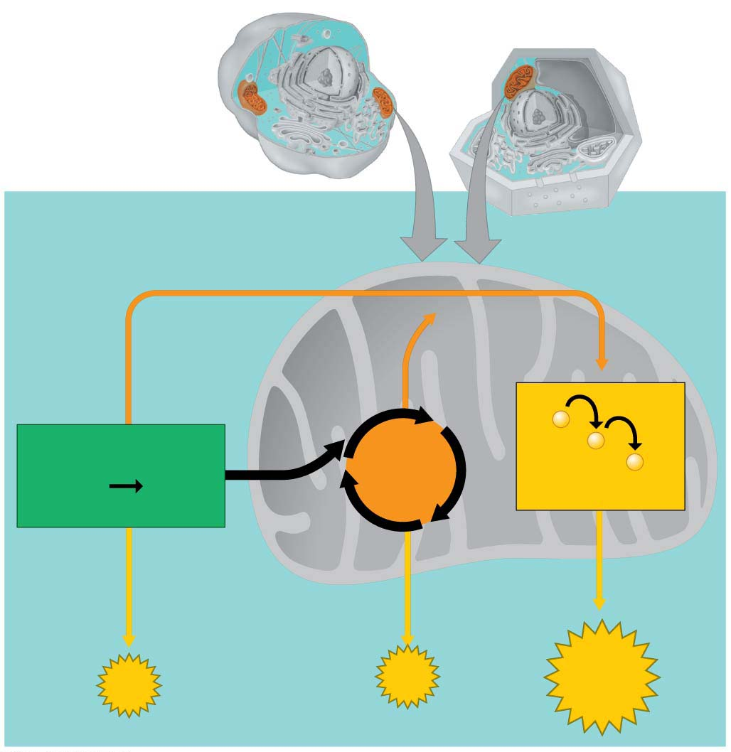
Figure 6.4
Mitochondria
Cytoplasm
Cytoplasm
Animal cell
Plant cell
Cytoplasm
Mitochondrion
High-energy
electrons
via carrier
molecules
−
Glycolysis
Citric
Acid
Cycle
−
2
Pyruvic
acid
−
Glucose
Electron
Transport Chain
Krebs cycle
ATP
ATP
ATP
Notes:
Figure 6.4 A road map for cellular respiration

Slide 7
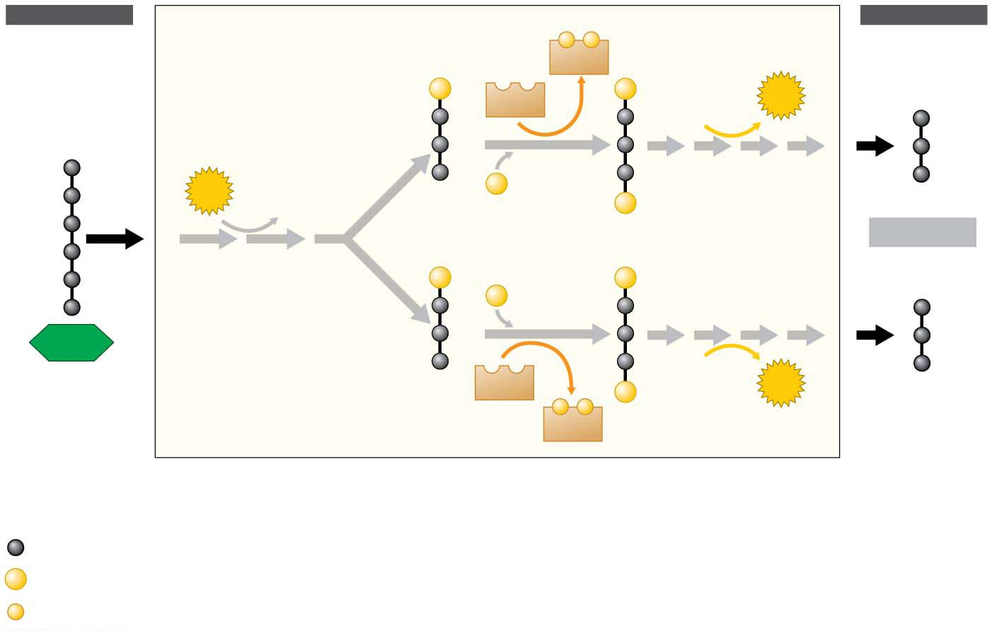
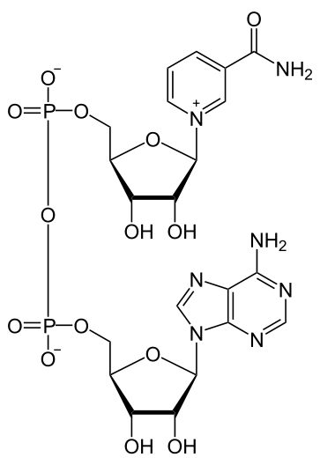
Figure 6.5
Glycolysis해당과정
INPUT
OUTPUT
−
−
NADH
P
NAD⁺
P
2
ATP
ADP
2
3
P
2
2
ATP
2
ADP
P
2 Pyruvic acid
P
P
P
2
3
1
Glucose
2
ADP
NAD⁺
P
2
ATP
−
−
NADH
Energy investment phase
Energy harvest phase
Key
Carbon atom
P
Phosphate group
NAD⁺ (oxidized form of nicotinamide adenine dinucleotide)
NADH (reduced form of NAD)
−
High-energy electron
Notes:
Figure 6.5 Glycolysis

Slide 8
Stage 2: The Citric Acid Cycle, Krebs Cycle, TCA cycle
The pyruvic acid must be “groomed”—converted to a form the citric acid cycle can use.
Each pyruvic acid loses a carbon as CO₂.The remaining fuel molecules, with only two carbons left, are called acetic acid.
Electrons are stripped from these molecules and transferred to another molecule of NAD⁺, forming more NADH.
Finally, each acetic acid is attached to a molecule called coenzyme A (CoA) to form acetyl CoA. The CoA escorts the acetic acid into the first reaction of the citric acid cycle and is then stripped and recycled.
Notes:
8
Student Misconceptions and Concerns
1. Perhaps more than anywhere else in general biology, students studying aerobic metabolism fail to see “the forest for the trees.” Students often focus on the details of each stage of aerobic metabolism and devote little attention to the overall process and products. Consider emphasizing the products, locations, and energy yields associated with glycolysis, the citric acid cycle, and electron transport before detailing the specifics of each reaction. Figure 6.4 can be especially helpful in providing physical orientation to these cellular processes.
2. Students often fail to realize that aerobic metabolism is a process generally similar to the burning of wood in a fireplace or campfire. Pointing out the general similarities can help students comprehend the overall reaction and heat generation associated with both processes.
3. The advantage of the gradual degradation of glucose may not be obvious to some students. Many analogies exist that reveal the advantages of short and steady steps. Fuel in an automobile is burned slowly to best utilize the energy released from the fuel. A few fireplace logs release gradual heat to keep a room temperature steady. In both situations, excessive use of fuel can be wasteful, reducing the efficiencies of the systems.
Teaching Tips
1. During cellular respiration, our cells convert about 40% of our food energy to useful work. The other 60% of the energy is released as heat. We use this heat to maintain a relatively steady body temperature near 37°C (98–99°F). This is about the same amount of heat generated by a 75-watt incandescent light bulb (depending upon the size of the person). If you choose to include a discussion of heat generated by aerobic metabolism, consider the following:
a. Ask your students why they feel warm when it is 30°C (86°F) outside if their core body temperature is 37°C (98.6°F). Shouldn’t they feel cold? The answer is that our bodies are always producing heat. At these higher temperatures, we are producing more heat than we need to maintain a body temperature around 37°C. Thus, we sweat and behave in ways that help us get rid of the extra heat from cellular respiration.
b. Share this calculation with your students. Depending on the size and activity of a person, a human might burn 2,000 dietary Calories (kilocalories) a day. This is enough energy to raise the temperature of 20 L of liquid water from 0 to 100°C. This is something to think about the next time you heat water on the stove! Consider bringing a 2-L bottle as a visual aid, or ten 2-L bottles to make the point above; 200 Calories raises 2 L of water 100°C. (Note: It takes much more energy to melt ice or evaporate water as steam.)
2. The production of NADH by glycolysis and the citric acid cycle, instead of just the direct production of ATP, can get confusing for students. Help students understand that NADH molecules have energy “value,” to be “cashed in” by the electron transport chain. The NADH can therefore be thought of as casino chips, accumulated along the way to be cashed in at the “electron transport” cashier.
3. The authors developed an analogy between the function of the inner mitochondrial membrane and a dam. A reservoir of hydrogen ions is built up between the mitochondrial membranes, like a dam holding water back. As the hydrogen ions move down their concentration gradient, they “spin” the ATP synthase, which helps generate ATP. In a dam, water rushing downhill turns giant turbines, which generate electricity.
4. Students should be reminded that the ATP yield per glucose molecule of up to 32 ATP is only a potential. The complex chemistry of aerobic metabolism can only yield this amount under the best conditions, when every substrate and enzyme is immediately available. Such circumstances may only rarely occur in a working cell.
Active Lecture Tips
1. As you relate the structure of the inner mitochondrial membrane to its functions, challenge students to explain the adaptive advantage of the many folds of this inner membrane. (These folds greatly increase the surface area available for the associated reactions.)
2. See the activity Cell Respiration: Pair and Share on the Instructor Exchange. Visit the Instructor Exchange in the MasteringBiology instructor resource area for a description of this activity.
3. See the activity Demonstration of Electron Transport and ATP Production in Aerobic Respiration Using Students and Balloons on the Instructor Exchange. Visit the Instructor Exchange in the MasteringBiology instructor resource area for a description of this activity.
4. Challenge your students to explain why most extra energy in the human body is stored as fat and not sugars or proteins. Have students work with others seated nearby. The general answer is this. The same mass of fat stores nearly twice as many calories (about 9 kcal per gram) as an equivalent mass of protein or carbohydrates (about 4.5 kcal per gram). Fat is therefore an efficient way to store energy in animals and many plants. To store an equivalent amount of energy in the form of carbohydrates or proteins would require about twice the mass, adding a significant burden to the organism’s structure. (For example, if you were 20 lb overweight, you would be nearly 40 lb overweight if the same energy were stored as carbohydrates or proteins instead of fat.)

Slide 9
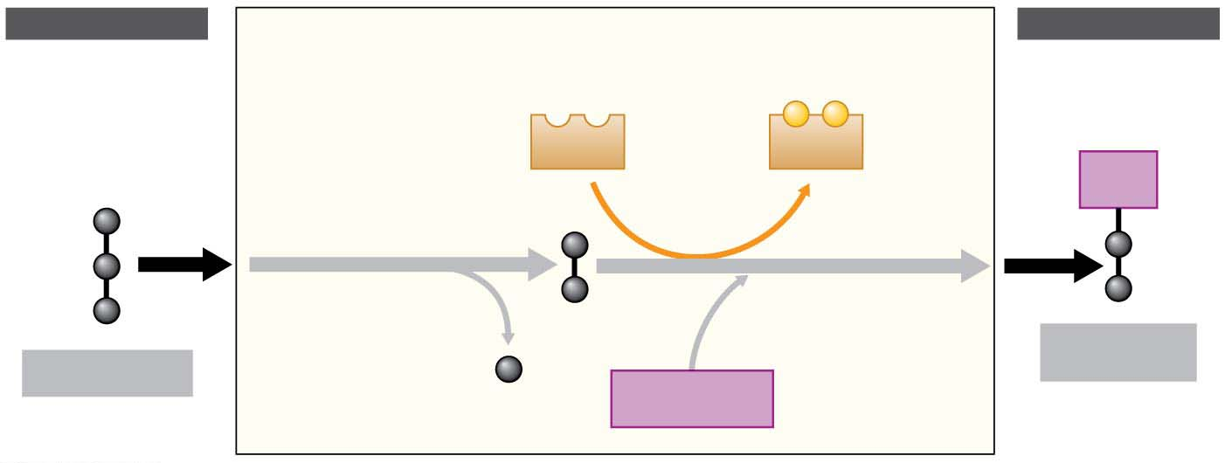
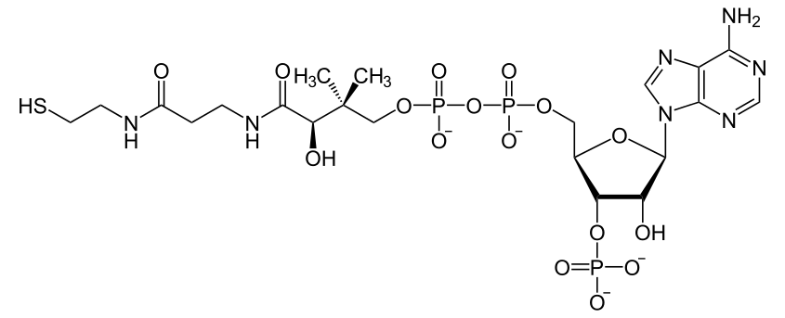
Figure 6.7
INPUT
OUTPUT
(from
glycolysis)
2
Breakdown of the fuel
generates NADH
(to citric
acid cycle)
−
−
NAD⁺
NADH
CoA
Pyruvic acid
loses a carbon
as CO₂
Acetic
acid
Acetic acid
attaches to
coenzyme A
1
3
Acetyl CoA
Pyruvic acid
CO₂
Coenzyme A
Notes:
Figure 6.7 The link between glycolysis and the citric acid cycle: the conversion of pyruvic acid to acetyl CoA

Slide 10
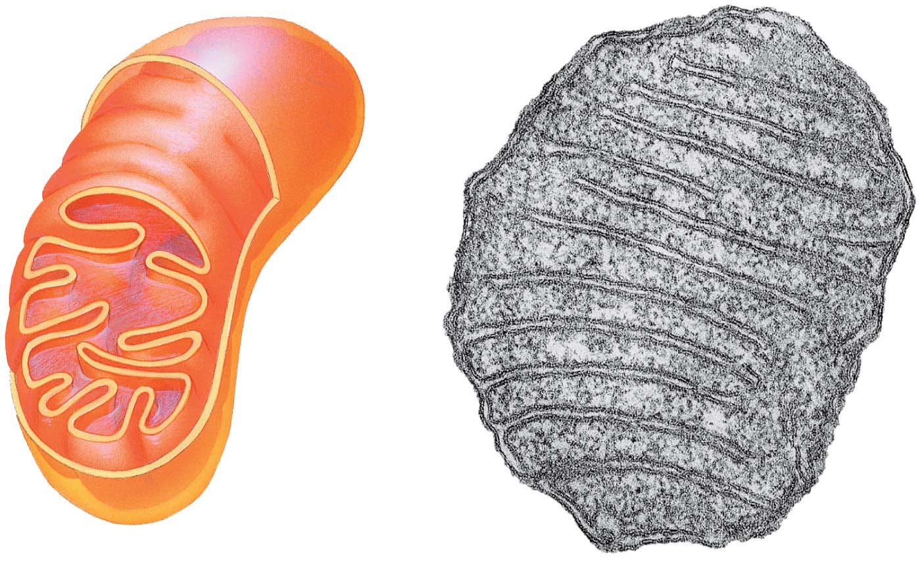
Figure 4.18
mitochondrion
Outer
membrane
TEM
Inner
membrane
Cristae
Matrix
Space between
membranes
Notes:
Figure 4.18 The mitochondrion: site of cellular respiration

Slide 11
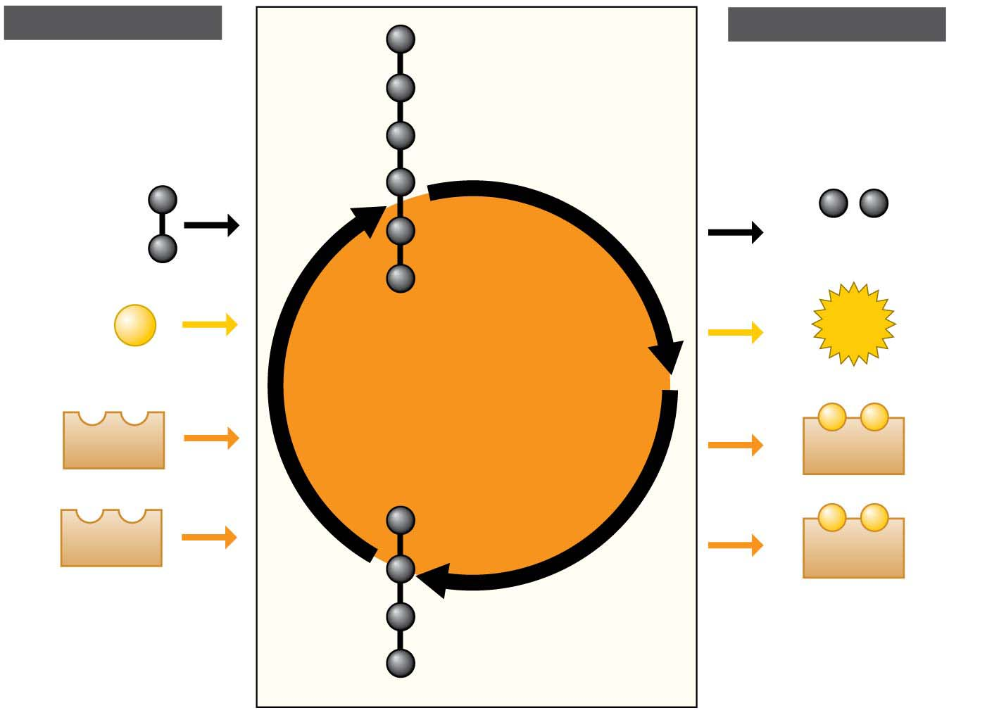
Figure 6.8
INPUT
OUTPUT
Citric
acid
Acetic
acid
2
CO₂
ADP
+
P
ATP
Citric
Acid
Cycle
−
−
3
NAD⁺
3
NADH
−
−
FAD
FADH₂
Acceptor
molecule
Notes:
Figure 6.8 The citric acid cycle

Slide 12
Electron Transport
During cellular respiration, the electrons gathered from food molecules “fall” in a stepwise cascade down an energy staircase, unlocking chemical energy in small amounts, bit by bit, that cells can put to productive use.
The transfer of electrons from organic fuel (food) to NAD⁺ converts it to NADH.
The rest of the staircase consists of an electron transport chain전자전달회로.
Notes:
12
Student Misconceptions and Concerns
1. Perhaps more than anywhere else in general biology, students studying aerobic metabolism fail to see “the forest for the trees.” Students often focus on the details of each stage of aerobic metabolism and devote little attention to the overall process and products. Consider emphasizing the products, locations, and energy yields associated with glycolysis, the citric acid cycle, and electron transport before detailing the specifics of each reaction. Figure 6.4 can be especially helpful in providing physical orientation to these cellular processes.
2. Students often fail to realize that aerobic metabolism is a process generally similar to the burning of wood in a fireplace or campfire. Pointing out the general similarities can help students comprehend the overall reaction and heat generation associated with both processes.
3. The advantage of the gradual degradation of glucose may not be obvious to some students. Many analogies exist that reveal the advantages of short and steady steps. Fuel in an automobile is burned slowly to best utilize the energy released from the fuel. A few fireplace logs release gradual heat to keep a room temperature steady. In both situations, excessive use of fuel can be wasteful, reducing the efficiencies of the systems.
Teaching Tips
1. During cellular respiration, our cells convert about 40% of our food energy to useful work. The other 60% of the energy is released as heat. We use this heat to maintain a relatively steady body temperature near 37°C (98–99°F). This is about the same amount of heat generated by a 75-watt incandescent light bulb (depending upon the size of the person). If you choose to include a discussion of heat generated by aerobic metabolism, consider the following:
a. Ask your students why they feel warm when it is 30°C (86°F) outside if their core body temperature is 37°C (98.6°F). Shouldn’t they feel cold? The answer is that our bodies are always producing heat. At these higher temperatures, we are producing more heat than we need to maintain a body temperature around 37°C. Thus, we sweat and behave in ways that help us get rid of the extra heat from cellular respiration.
b. Share this calculation with your students. Depending on the size and activity of a person, a human might burn 2,000 dietary Calories (kilocalories) a day. This is enough energy to raise the temperature of 20 L of liquid water from 0 to 100°C. This is something to think about the next time you heat water on the stove! Consider bringing a 2-L bottle as a visual aid, or ten 2-L bottles to make the point above; 200 Calories raises 2 L of water 100°C. (Note: It takes much more energy to melt ice or evaporate water as steam.)
2. The production of NADH by glycolysis and the citric acid cycle, instead of just the direct production of ATP, can get confusing for students. Help students understand that NADH molecules have energy “value,” to be “cashed in” by the electron transport chain. The NADH can therefore be thought of as casino chips, accumulated along the way to be cashed in at the “electron transport” cashier.
3. The authors developed an analogy between the function of the inner mitochondrial membrane and a dam. A reservoir of hydrogen ions is built up between the mitochondrial membranes, like a dam holding water back. As the hydrogen ions move down their concentration gradient, they “spin” the ATP synthase, which helps generate ATP. In a dam, water rushing downhill turns giant turbines, which generate electricity.
4. Students should be reminded that the ATP yield per glucose molecule of up to 32 ATP is only a potential. The complex chemistry of aerobic metabolism can only yield this amount under the best conditions, when every substrate and enzyme is immediately available. Such circumstances may only rarely occur in a working cell.
Active Lecture Tips
1. As you relate the structure of the inner mitochondrial membrane to its functions, challenge students to explain the adaptive advantage of the many folds of this inner membrane. (These folds greatly increase the surface area available for the associated reactions.)
2. See the activity Cell Respiration: Pair and Share on the Instructor Exchange. Visit the Instructor Exchange in the MasteringBiology instructor resource area for a description of this activity.
3. See the activity Demonstration of Electron Transport and ATP Production in Aerobic Respiration Using Students and Balloons on the Instructor Exchange. Visit the Instructor Exchange in the MasteringBiology instructor resource area for a description of this activity.
4. Challenge your students to explain why most extra energy in the human body is stored as fat and not sugars or proteins. Have students work with others seated nearby. The general answer is this. The same mass of fat stores nearly twice as many calories (about 9 kcal per gram) as an equivalent mass of protein or carbohydrates (about 4.5 kcal per gram). Fat is therefore an efficient way to store energy in animals and many plants. To store an equivalent amount of energy in the form of carbohydrates or proteins would require about twice the mass, adding a significant burden to the organism’s structure. (For example, if you were 20 lb overweight, you would be nearly 40 lb overweight if the same energy were stored as carbohydrates or proteins instead of fat.)

Slide 13
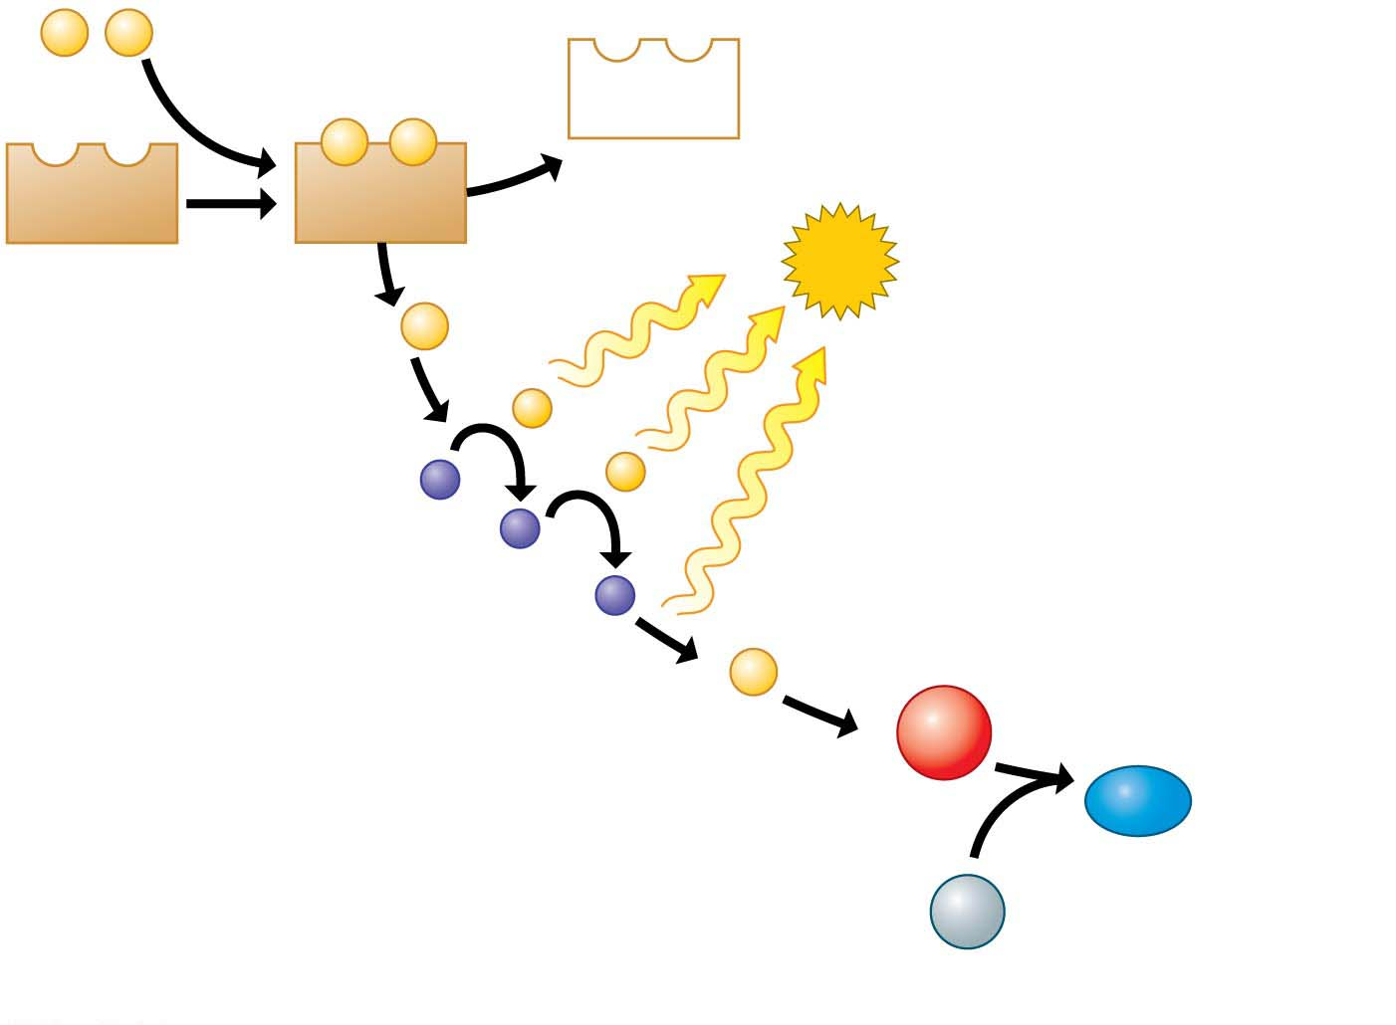
Figure 6.9
e⁻
e⁻
Electrons from food
NAD⁺
e–
e–
NAD⁺
NADH
Stepwise release
of energy used
to make ATP
ATP
2
e⁻
−
−
Electron
transport
chain
2
e⁻
1
O₂
2
H₂O
Hydrogens,
electrons, and
oxygen combine to
form water
2
H⁺
Notes:
Figure 6.9 The role of oxygen in harvesting food energy

Slide 14
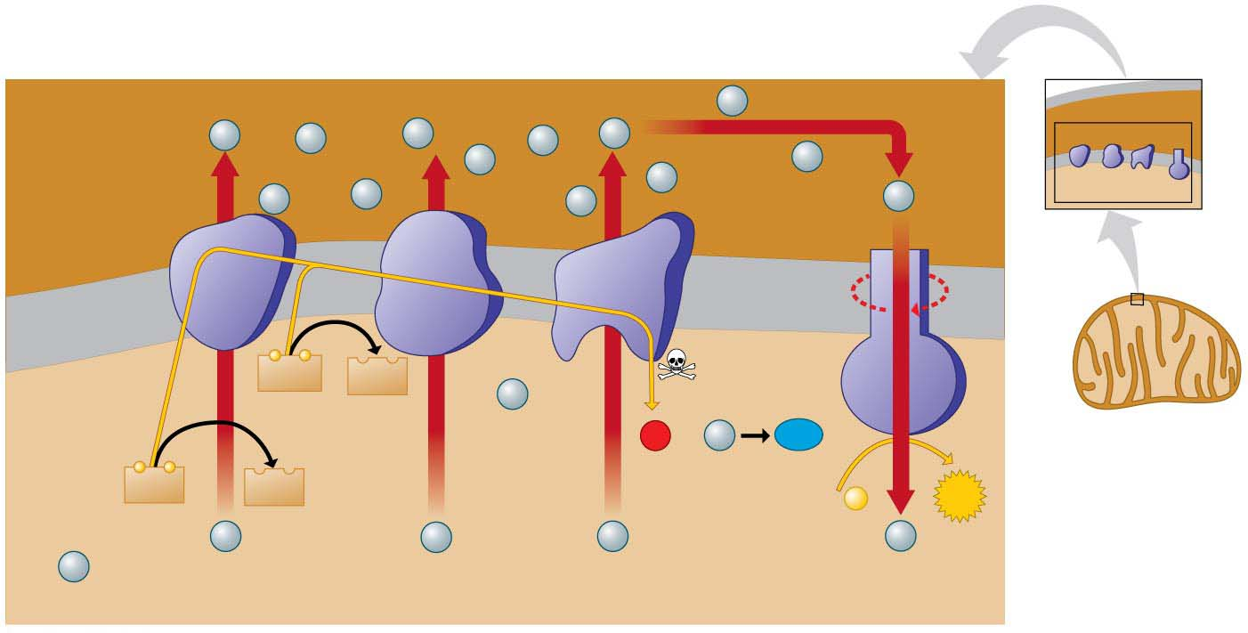
Figure 6.10
Space
between
membranes
H⁺
H⁺
H⁺
H⁺
H⁺
H⁺
H⁺
Electron
carrier
H⁺
H⁺
H⁺
3
H⁺
H⁺
Protein
complex
H⁺
H⁺
5
Inner
mitochondrial
membrane
−
−
FADH₂
FAD
Electron
flow
2
H⁺
1
H₂O
O₂
H⁺
6
2
2
−
−
4
NADH
NAD⁺
+
ATP
ADP
P
1
H⁺
H⁺
H⁺
H⁺
H⁺
Matrix
Electron transport chain
ATP synthase
Notes:
Figure 6.10 How electron transport drives ATP synthase machines

Slide 15
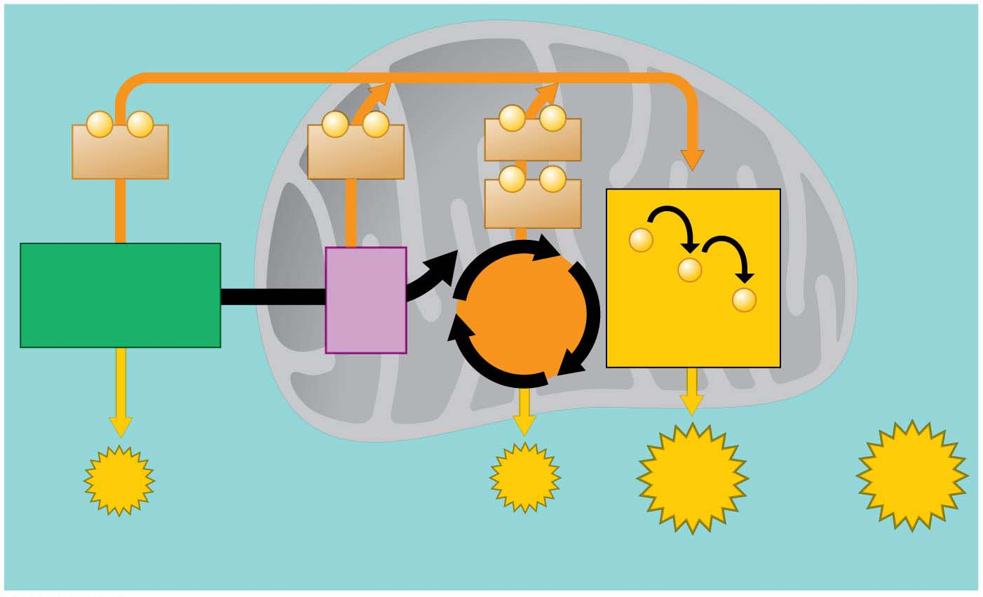
Figure 6.11
Cytoplasm
Mitochondrion
−
−
−
−
−
−
2
NADH
2
NADH
6
NADH
−
−
2
FADH₂
−
Glycolysis
2
Acetyl
CoA
−
2
Pyruvic
acid
Citric
Acid
Cycle
−
Glucose
Electron
Transport Chain
Maximum
per
glucose:
2
ATP
2
ATP
About
28 ATP
About
32 ATP
by direct
synthesis
by direct
synthesis
by ATP
synthase
Notes:
Figure 6.11 A summary of ATP yield during cellular respiration

Slide 16
The Results of Cellular Respiration
Respiration is a versatile metabolic furnace that can “burn” many other kinds of food molecules.
Figure 6.12 diagrams some metabolic routes for the use of carbohydrates, fats, and proteins as fuel for cellular respiration.
Notes:
16
Student Misconceptions and Concerns
1. Perhaps more than anywhere else in general biology, students studying aerobic metabolism fail to see “the forest for the trees.” Students often focus on the details of each stage of aerobic metabolism and devote little attention to the overall process and products. Consider emphasizing the products, locations, and energy yields associated with glycolysis, the citric acid cycle, and electron transport before detailing the specifics of each reaction. Figure 6.4 can be especially helpful in providing physical orientation to these cellular processes.
2. Students often fail to realize that aerobic metabolism is a process generally similar to the burning of wood in a fireplace or campfire. Pointing out the general similarities can help students comprehend the overall reaction and heat generation associated with both processes.
3. The advantage of the gradual degradation of glucose may not be obvious to some students. Many analogies exist that reveal the advantages of short and steady steps. Fuel in an automobile is burned slowly to best utilize the energy released from the fuel. A few fireplace logs release gradual heat to keep a room temperature steady. In both situations, excessive use of fuel can be wasteful, reducing the efficiencies of the systems.
Teaching Tips
1. During cellular respiration, our cells convert about 40% of our food energy to useful work. The other 60% of the energy is released as heat. We use this heat to maintain a relatively steady body temperature near 37°C (98–99°F). This is about the same amount of heat generated by a 75-watt incandescent light bulb (depending upon the size of the person). If you choose to include a discussion of heat generated by aerobic metabolism, consider the following:
a. Ask your students why they feel warm when it is 30°C (86°F) outside if their core body temperature is 37°C (98.6°F). Shouldn’t they feel cold? The answer is that our bodies are always producing heat. At these higher temperatures, we are producing more heat than we need to maintain a body temperature around 37°C. Thus, we sweat and behave in ways that help us get rid of the extra heat from cellular respiration.
b. Share this calculation with your students. Depending on the size and activity of a person, a human might burn 2,000 dietary Calories (kilocalories) a day. This is enough energy to raise the temperature of 20 L of liquid water from 0 to 100°C. This is something to think about the next time you heat water on the stove! Consider bringing a 2-L bottle as a visual aid, or ten 2-L bottles to make the point above; 200 Calories raises 2 L of water 100°C. (Note: It takes much more energy to melt ice or evaporate water as steam.)
2. The production of NADH by glycolysis and the citric acid cycle, instead of just the direct production of ATP, can get confusing for students. Help students understand that NADH molecules have energy “value,” to be “cashed in” by the electron transport chain. The NADH can therefore be thought of as casino chips, accumulated along the way to be cashed in at the “electron transport” cashier.
3. The authors developed an analogy between the function of the inner mitochondrial membrane and a dam. A reservoir of hydrogen ions is built up between the mitochondrial membranes, like a dam holding water back. As the hydrogen ions move down their concentration gradient, they “spin” the ATP synthase, which helps generate ATP. In a dam, water rushing downhill turns giant turbines, which generate electricity.
4. Students should be reminded that the ATP yield per glucose molecule of up to 32 ATP is only a potential. The complex chemistry of aerobic metabolism can only yield this amount under the best conditions, when every substrate and enzyme is immediately available. Such circumstances may only rarely occur in a working cell.
Active Lecture Tips
1. As you relate the structure of the inner mitochondrial membrane to its functions, challenge students to explain the adaptive advantage of the many folds of this inner membrane. (These folds greatly increase the surface area available for the associated reactions.)
2. See the activity Cell Respiration: Pair and Share on the Instructor Exchange. Visit the Instructor Exchange in the MasteringBiology instructor resource area for a description of this activity.
3. See the activity Demonstration of Electron Transport and ATP Production in Aerobic Respiration Using Students and Balloons on the Instructor Exchange. Visit the Instructor Exchange in the MasteringBiology instructor resource area for a description of this activity.
4. Challenge your students to explain why most extra energy in the human body is stored as fat and not sugars or proteins. Have students work with others seated nearby. The general answer is this. The same mass of fat stores nearly twice as many calories (about 9 kcal per gram) as an equivalent mass of protein or carbohydrates (about 4.5 kcal per gram). Fat is therefore an efficient way to store energy in animals and many plants. To store an equivalent amount of energy in the form of carbohydrates or proteins would require about twice the mass, adding a significant burden to the organism’s structure. (For example, if you were 20 lb overweight, you would be nearly 40 lb overweight if the same energy were stored as carbohydrates or proteins instead of fat.)

Slide 17
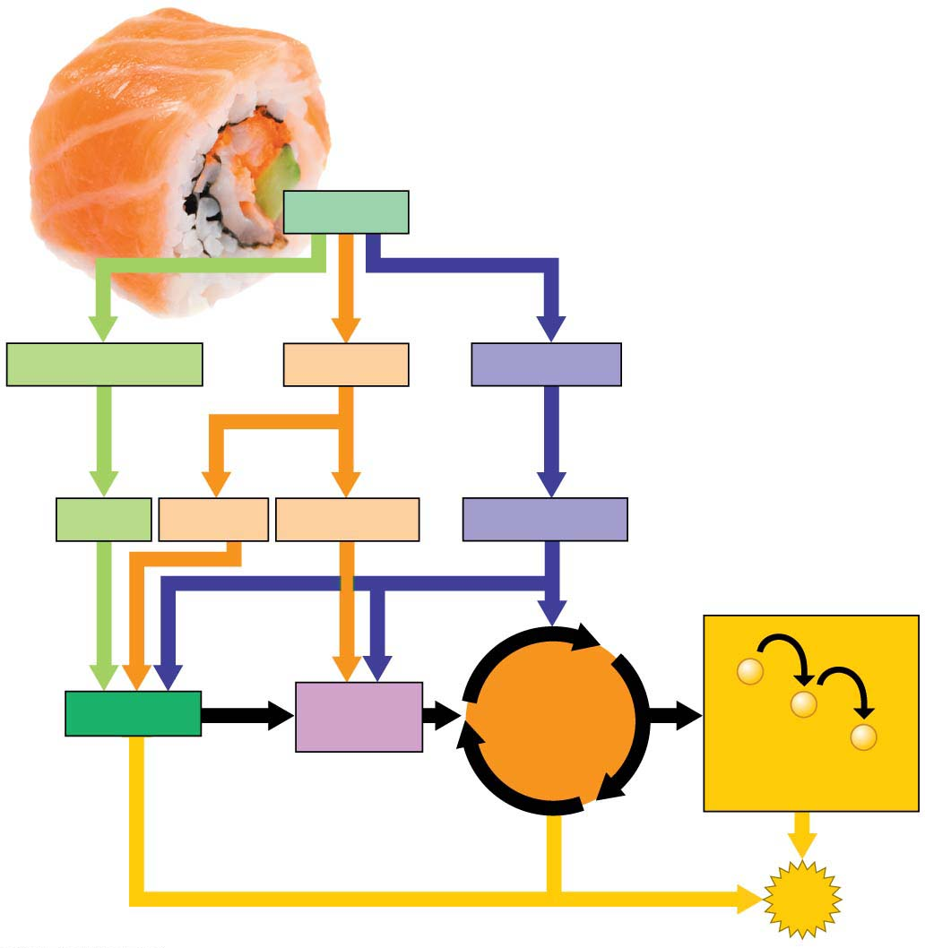
Figure 6.12
Food
Carbohydrates
Fats
Proteins
Sugars
Glycerol
Fatty acids
Amino acids
−
Glycolysis
Acetyl
CoA
Citric
Acid
Cycle
−
−
Electron
Transport Chain
ATP
Notes:
Figure 6.12 Energy from food

Slide 18
Fermentation발효: Anaerobic무산소 Harvest of Food Energy
Some of your cells can actually work for short periods without oxygen. After functioning anaerobically for about 15 seconds, muscle cells begin to generate ATP by the process of fermentation.
Fermentation is the anaerobic (without oxygen) harvest of food energy. NADH disposes of electrons by adding them to the pyruvic acid produced by glycolysis (Figure 6.13).
This restores NAD⁺ and keeps glycolysis working.
Notes:
18
Student Misconceptions and Concerns
1. Some students might expect that fermentation produces alcohol and perhaps carbon dioxide. Care should be taken to clarify the different possible products of fermentation in lactic acid fermentation in muscle cells and alcoholic fermentation used in the food and beverage industry.
2. The text notes that some microbes are useful in the dairy industry because they produce lactic acid. However, the impact of acids on milk may not be obvious to many students. Consider a simple demonstration in which you mix about equal portions of milk (skim or 2%) and acid (vinegar will work). Notice the accumulation of strands of milk curd (protein) on the side of the container and stirring device.
Teaching Tips
1. The carbon dioxide released from fermentation also makes beer and champagne bubbly.
2. Dry wines are produced when the yeast cells use up all or most of the sugar available. Sweet wines result when the alcohol accumulates enough to inhibit fermentation before the sugar is depleted.
3. Exposing fermenting yeast to oxygen will slow or stop the process, because the yeast will switch back to aerobic respiration. When fermentation is rapid, the carbon dioxide produced drives away the immediate oxygen above the wine. However, as fermentation slows down, the wine must be sealed to prevent oxygen exposure and permit the fermentation process to finish.
Active Lecture Tips
1. See the activity Aerobic Respiration Gives a Cell More “Spending Power” on the Instructor Exchange. Visit the Instructor Exchange in the MasteringBiology instructor resource area for a description of this activity.

Slide 19
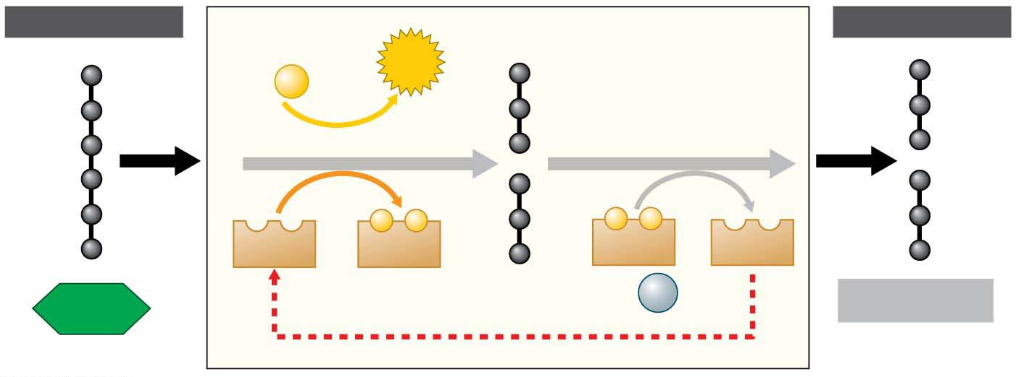
Figure 6.13-1
INPUT
OUTPUT
2 ADP
2
ATP
+ 2
P
Glycolysis
−
−
−
−
2
NAD⁺
2
NADH
2
NADH
2
NAD⁺
2 pyruvic
acid
+ 2
H⁺
2 lactic acid
Glucose
The lactic acid by-product is eventually transported to the liver, where liver cells convert it back to pyruvic acid.
Notes:
Figure 6.13-1 Fermentation: producing lactic acid (part 1: detail)

Slide 20
Fermentation in Microorganisms
Fermentation alone is enough to sustain many microorganisms.
The lactic acid produced by yeast using lactic acid fermentation is used to produce
cheese, sour cream, and yogurt,
soy sauce, pickles, cabbage, and olives, and
sausage meat products.
Yeast
is capable of cellular respiration and fermentation and
can perform alcoholic fermentation to produce CO₂ and ethyl alcohol instead of lactic acid.
For thousands of years, people have put yeast to work producing alcoholic beverages such as beer and wine.
As every baker knows, the CO₂ bubbles from fermenting yeast also cause bread dough to rise.
Notes:
20
Student Misconceptions and Concerns
1. Some students might expect that fermentation produces alcohol and perhaps carbon dioxide. Care should be taken to clarify the different possible products of fermentation in lactic acid fermentation in muscle cells and alcoholic fermentation used in the food and beverage industry.
2. The text notes that some microbes are useful in the dairy industry because they produce lactic acid. However, the impact of acids on milk may not be obvious to many students. Consider a simple demonstration in which you mix about equal portions of milk (skim or 2%) and acid (vinegar will work). Notice the accumulation of strands of milk curd (protein) on the side of the container and stirring device.
Teaching Tips
1. The carbon dioxide released from fermentation also makes beer and champagne bubbly.
2. Dry wines are produced when the yeast cells use up all or most of the sugar available. Sweet wines result when the alcohol accumulates enough to inhibit fermentation before the sugar is depleted.
3. Exposing fermenting yeast to oxygen will slow or stop the process, because the yeast will switch back to aerobic respiration. When fermentation is rapid, the carbon dioxide produced drives away the immediate oxygen above the wine. However, as fermentation slows down, the wine must be sealed to prevent oxygen exposure and permit the fermentation process to finish.
Active Lecture Tips
1. See the activity Aerobic Respiration Gives a Cell More “Spending Power” on the Instructor Exchange. Visit the Instructor Exchange in the MasteringBiology instructor resource area for a description of this activity.

Slide 21
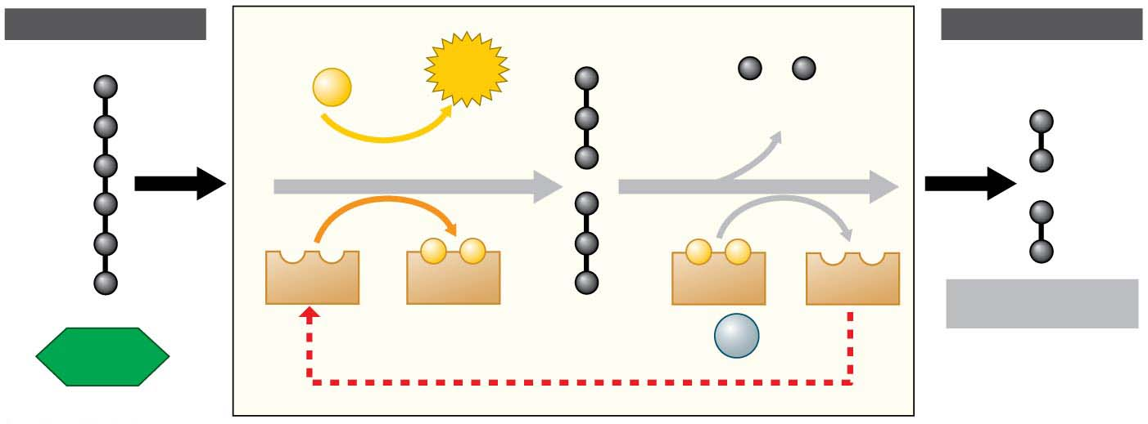
Figure 6.15
INPUT
OUTPUT
2 ADP
2
ATP
+ 2
P
P
2 CO₂ released
Glycolysis
−
−
−
−
2
NAD⁺
2
NADH
2
NADH
2
NAD⁺
2 Ethyl alcohol
2 pyruvic acid
+ 2
H⁺
Glucose
Notes:
Figure 6.15 Fermentation: producing ethyl alcohol

Slide 22
Evolution Connection: The Importance of Oxygen
The role of glycolysis in both respiration and fermentation has an evolutionary basis.
Between 3.5 and 2.7 billion years ago, before significant levels of oxygen were present in Earth’s atmosphere, ancient prokaryotes probably
used glycolysis to make ATP and
generated ATP exclusively from glycolysis.
The fact that glycolysis occurs in almost all organisms suggests that it evolved very early in ancestors common to all the domains of life.
The location of glycolysis within the cell also implies great antiquity.
The pathway does not require any of the membrane-enclosed organelles of the eukaryotic cell, which evolved more than a billion years after the prokaryotic cell.
Notes:
22
Student Misconceptions and Concerns
1. Some students might expect that fermentation produces alcohol and perhaps carbon dioxide. Care should be taken to clarify the different possible products of fermentation in lactic acid fermentation in muscle cells and alcoholic fermentation used in the food and beverage industry.
2. The text notes that some microbes are useful in the dairy industry because they produce lactic acid. However, the impact of acids on milk may not be obvious to many students. Consider a simple demonstration in which you mix about equal portions of milk (skim or 2%) and acid (vinegar will work). Notice the accumulation of strands of milk curd (protein) on the side of the container and stirring device.
Teaching Tips
1. The carbon dioxide released from fermentation also makes beer and champagne bubbly.
2. Dry wines are produced when the yeast cells use up all or most of the sugar available. Sweet wines result when the alcohol accumulates enough to inhibit fermentation before the sugar is depleted.
3. Exposing fermenting yeast to oxygen will slow or stop the process, because the yeast will switch back to aerobic respiration. When fermentation is rapid, the carbon dioxide produced drives away the immediate oxygen above the wine. However, as fermentation slows down, the wine must be sealed to prevent oxygen exposure and permit the fermentation process to finish.
Active Lecture Tips
1. See the activity Aerobic Respiration Gives a Cell More “Spending Power” on the Instructor Exchange. Visit the Instructor Exchange in the MasteringBiology instructor resource area for a description of this activity.

